Slide 1
Lec: 23 - SFSS - SP – 04c
Causes of Poverty

Slide 2
Causes
Of
Poverty

Slide 3
Personal
Economic
Social
Causes
of
Poverty
Political
Geographical
Disaster

Slide 4
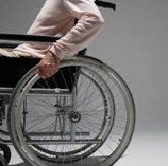
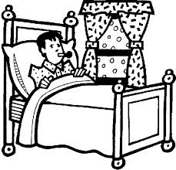
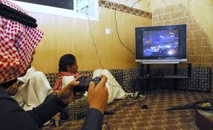
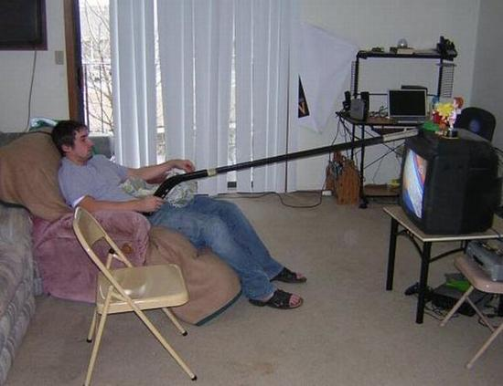
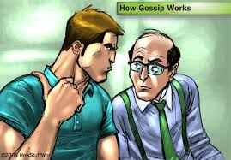
Personal
Sickness / Disabilities
Illiteracy / Less Education
Less Income & More Expenditure
Idleness
Large Family

Slide 5
Economic
Low Income Low Resources
Low Saving Low Investment
Inflation Low Bargaining Power
Unemployment

Slide 6
Social
Old Tradition & Custom Litigation
Non Productive Expenditure Fatalism
Non Working of Family Kinship
Faction & Feuds Crime
Drugs Addiction Bad Company
Lack of Technical Education Tends / updated centers

Slide 7
Political
Nepotism Corruption
Wrong Politics / Wrong Policies
Destruction Political Instability

Slide 8
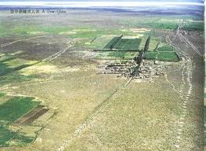
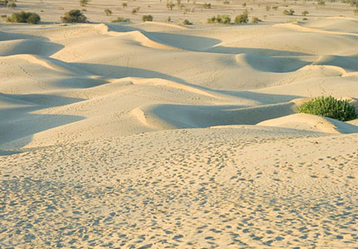
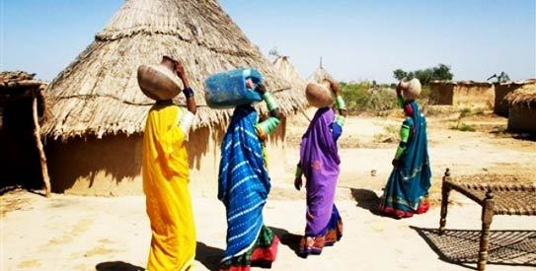
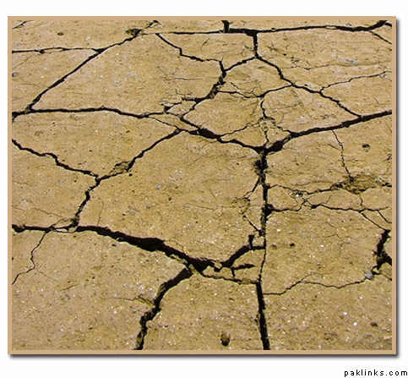
Geographical
Un-Developed Area
Poor Natural Resources
High Mountains

Slide 9
Disaster
Natural Disaster:
Man-Made Disaster:

Slide 10
Thanks

